Slide 1
Water irrigation with linux
By Vaishnavi(22BRS1340)
YOGASRINITHI(22BRS1347)

Slide 2
Algorithms used
Algorithms used:
Real time

Slide 3
Why irrigation?
irrigation is the artificial application of water to soil or land to assist in the growth of plants, particularly in areas with insufficient or irregular rainfall. It is a critical agricultural practice and has several important purposes and benefits:
Mitigating Drought: Irrigation can mitigate the impact of droughts by providing a stable water source even when natural water sources are scarce. This can be a lifeline for farmers during periods of water scarcity.
Soil Improvement: Controlled irrigation can help manage soil salinity and prevent soil erosion, contributing to soil health and sustainability.

Slide 4
Why cpu scheduling
Multiprogramming: In a multitasking or multiprogramming environment, multiple processes or tasks compete for CPU time. CPU scheduling determines which task runs next and for how long. This allows the operating system to provide the illusion of concurrent execution even on a single-core CPU.
Fairness: CPU scheduling helps ensure that all processes receive their fair share of CPU time. This prevents any single process from monopolizing the CPU and ensures that no process is unfairly starved of resources.
Efficiency: Efficient scheduling can significantly improve the overall system performance. By minimizing idle CPU time and reducing the time it takes for processes to complete their execution, the system can be more responsive and productive.
Resource Utilization: Effective CPU scheduling ensures that the CPU is utilized efficiently. It can help maximize the use of computing resources, reducing the time processes spend waiting in a queue.

Slide 5
Reasons why real time cpu better for our project
On the other hand, FCFS and round-robin scheduling have limitations that make them less suitable for irrigation systems:
FCFS does not consider timing or deadlines, so it may lead to unpredictable and potentially delayed watering, which is undesirable in an irrigation context.
real-time systems consist of several components that work together to ensure timely task execution. These components include:
Real-Time Tasks
Priority-Based Scheduling
Deadlines and Timing Constraints
Interrupt Handling Mechanisms

Slide 6
why not round robin?
Fixed Time Quantum: Round-robin scheduling assigns each task a fixed time quantum during which it can execute. In the context of an irrigation system, this would mean that each irrigation task gets an equal amount of time to execute, regardless of the actual need for irrigation. Some tasks may not require execution at every time slice.
Not Event-Driven: Round-robin scheduling is not event-driven, meaning it doesn't take into account external events or conditions like soil moisture levels. In contrast, an irrigation system should react to the real-time condition of the plants (moisture levels) and schedule irrigation as needed.
Wasted CPU Time: In round-robin scheduling, even if a plant doesn't need irrigation, CPU time is allocated to that task. This can result in inefficient CPU usage and wasted energy.

Slide 7
Code description
The code then checks if the current soil moisture level is below the moisture threshold for each irrigation task. If the current moisture level is below the threshold, the irrigation task is executed immediately, and there is no delay. This is indicated by the message:
"PID <task_id>: Initiating irrigation. Moisture level is below the threshold."
If the current moisture level is above the threshold for an irrigation task, the code calculates a delay for the task to execute based on how far above the threshold the current moisture level is. The delay is calculated as follows:
delay = (int)(current_moisture - threshold);
The delay is then used to schedule the execution of the irrigation task. The message printed is:
"PID <task_id>: Irrigation postponed. Will execute in <delay> minutes."
The execution time or delay represents the amount of time the irrigation task needs to wait before it can be executed. It is calculated based on the difference between the current soil moisture level and the desired moisture threshold. If the current moisture level is already below the threshold, there is no delay, and the task is executed immediately.

Slide 8
Codr for round robin
#include <stdio.h>
#include <stdlib.h>
// Structure to represent irrigation tasks
struct IrrigationTask {
int pid; // Process ID
int duration;
double moisture_threshold;
};
// Function to simulate soil moisture readings (replace with actual sensor data)
double getSoilMoisture() {
// Simulate random soil moisture readings for demonstration.
return (rand() % 100) + 1; // Range: 1 to 100
}
// Function to perform irrigation task
void performIrrigation(struct IrrigationTask task) {
double current_moisture = getSoilMoisture();
if (current_moisture < task.moisture_threshold) {
// Execute the irrigation task
printf("PID %d: Initiating irrigation. Moisture level is below the threshold.\n", task.pid);
} else {
printf("PID %d: Skipping irrigation. Soil moisture is above the threshold.\n", task.pid);
}
}
nt main() {
int n; // Number of irrigation tasks
printf("Enter the number of irrigation tasks: ");
scanf("%d", &n);
struct IrrigationTask tasks[n];
// Input irrigation task details
for (int i = 0; i < n; i++) {
tasks[i].pid = i + 1; // Assign a unique PID to each task
printf("Enter duration for PID %d (in minutes): ", i + 1);
scanf("%d", &tasks[i].duration);
printf("Enter moisture threshold for PID %d: ", i + 1);
scanf("%lf", &tasks[i].moisture_threshold);
}
// Simulate round-robin irrigation scheduling
while (1) {
for (int i = 0; i < n; i++) {
performIrrigation(tasks[i]);
}
}
return 0;
}

Slide 9
Code for real time
include <stdio.h>
#include <stdlib.h>
// Structure to represent irrigation tasks
struct IrrigationTask {
int pid; // Process ID
int duration;
double moisture_threshold;
int next_execution_time;
};
/ Function to simulate soil moisture readings (replace with actual sensor data)
double getSoilMoisture() {
// Simulate random soil moisture readings for demonstration.
return (rand() % 100) + 1; // Range: 1 to 100
}
// Function to determine the next execution time based on soil moisture
int calculateNextExecutionTime(double current_moisture, double threshold) {
if (current_moisture < threshold) {
return 0; // Execute immediately if moisture is below the threshold
} else {
// Calculate a delay based on how far above the threshold the moisture is
int delay = (int)(current_moisture - threshold);
return delay;
}
}

Slide 10
Code for real time
/ Hybrid irrigation scheduler
void hybridIrrigationScheduler(struct IrrigationTask tasks[], int n) {
for (int i = 0; i < n; i++) {
tasks[i].pid = i + 1; // Assign a unique PID to each task
double current_moisture = getSoilMoisture();
if (current_moisture < tasks[i].moisture_threshold) {
// Execute immediately if moisture is below the threshold
printf("PID %d: Initiating irrigation. Moisture level is below the threshold.\n", tasks[i].pid);
} else {
int delay = calculateNextExecutionTime(current_moisture, tasks[i].moisture_threshold);
tasks[i].next_execution_time = delay;
printf("PID %d: Irrigation postponed. Will execute in %d minutes.\n", tasks[i].pid, delay);
}
}
}

Slide 11
Code for real time
int main() {
int n; // Number of irrigation tasks
printf("Enter the number of irrigation tasks: ");
scanf("%d", &n);
struct IrrigationTask tasks[n];
// Input irrigation task details
for (int i = 0; i < n; i++) {
tasks[i].pid = i + 1; // Assign a unique PID to each task
printf("Enter duration for PID %d (in minutes): ", i + 1);
scanf("%d", &tasks[i].duration);
printf("Enter moisture threshold for PID %d: ", i + 1);
scanf("%lf", &tasks[i].moisture_threshold);
}
// Simulate hybrid irrigation scheduling
hybridIrrigationScheduler(tasks, n);
return 0;
}

Slide 12
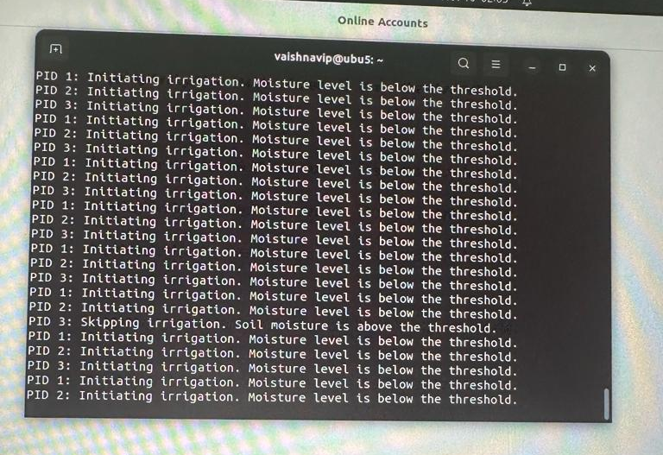
Round robin result
Conclusion: From round robin result we can see that this scheduling is not a preferred method for irrigation. When the plants are watered one at time(task1,2,..) it should be ensured that the a plant should get the required amount of water. But when round robin is used, we can see that another task is executed before fully watering the previous one.
Additionally ,even if a plant doesn’t need irrigation, CPU TIME IS ALLOCATED to the task. Thus, resulting in inefficient cpu usage and wated energy. This method is also not event-driven. From the result, some tasks that need no execution gets equal amount of time regardless of actual need of irrigation.

Slide 13
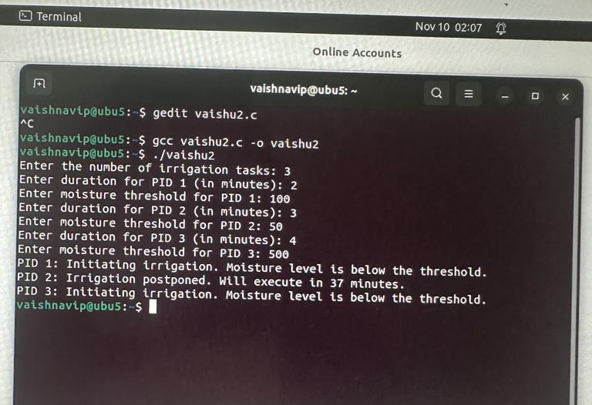
Real time SCHEDULING
CONCLUSION: THE RESULT SHOW THAT REAL TIME SCHEDULING IS BETTER THAN ROUND ROBIN AS CPU TIME IS NOT WASTED. EACH AND EVERY PLANT GETS ENOUGH WATER BEFORE MOVING TO WATERING THE OTHER. MOST IMPORNTANLY, THIS IS EVENT DRIVEN, MEANING IT TAKE INTO ACCOUNT EXTERNAL EVENTS OR CONDITION LIKE MOISTURE SENSOR. WHEN SOME TASKS NEED NO EXECUTION IT IS NOT EXECUTED.

Slide 14
FINAL CONCLUSION:REAL TIME SCHEDULING IS PREFERRED TO ROUND ROBIN
THE END

